Slide 1


News Sentiment Analysis and Stock Price Impact
Presented by Group 1

Slide 2

CONTENT
01
Context
02
Motivation
03
Objectives
04
Methodology
05
Result
06
Discussion

Slide 3

Context
Practical Problem
The financial market faces significant challenges in accurately predicting stock prices, which are influenced by a multitude of factors including historical data and market sentiment
Traditional stock prediction model
Focus only on historical prices, missing real-time market sentiment

Slide 4
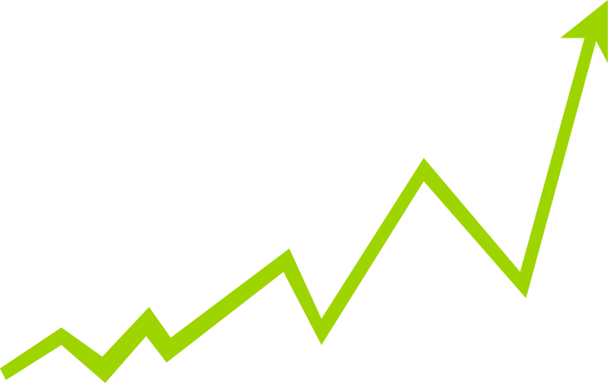
Motivation
Real-time Sentiment Analysis
Advancements in Technology
Capturing public sentiment from news reveals market psychology.
The rise of machine learning and NLP makes it easier to enhance stock price forecasting by integrating sentiment analysis.

Slide 5

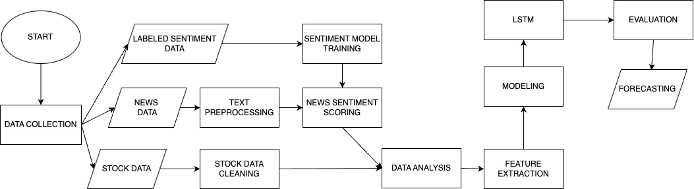
METHODOLOGY
01

Slide 6
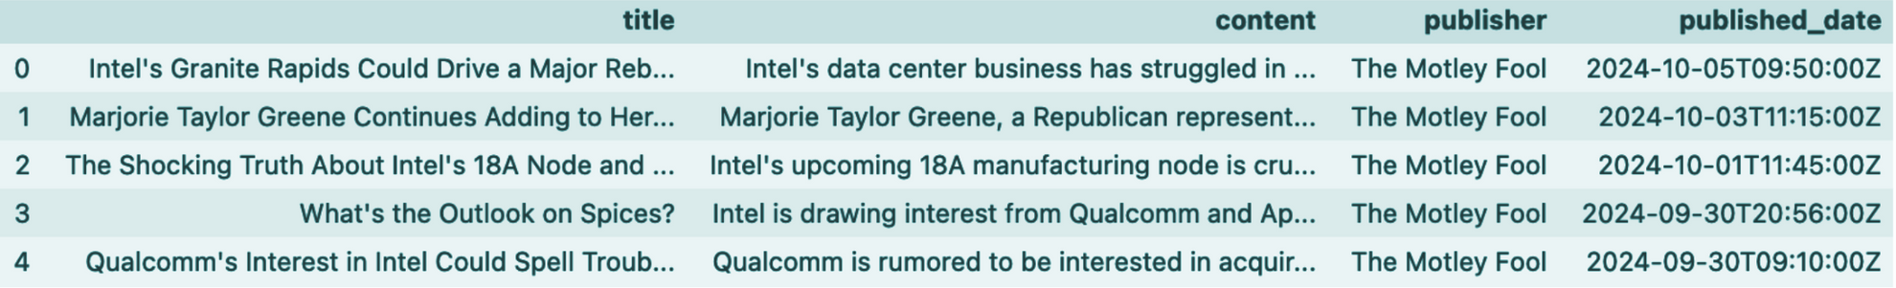
Data Preprocessing
Data Collection
01
Analyzed stocks with varying beta values: Microsoft (0.96), Intel (1.5), NVIDIA (2.42) to study news sentiment impact across volatility levels.
30000+ English News Articles and stock data over from 27/4/2021 to now

Slide 7
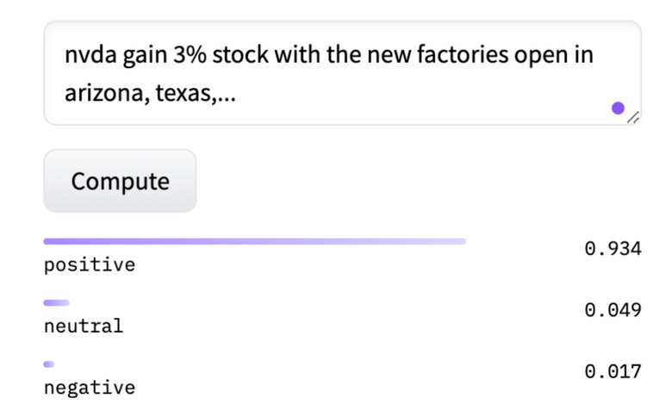
02
03
Data preprocessing
FinBERT Fine-tuning
Standardized date formats, removed duplicates, eliminated redundant text and titles, and filtered out stopwords, merging non-opening day with opening-day market like Saturday, Sunday are merged with Monday or at the end of holiday
Used Financial PhraseBank dataset to fine-tune FinBERT model, improving sentiment analysis performance.

Slide 8
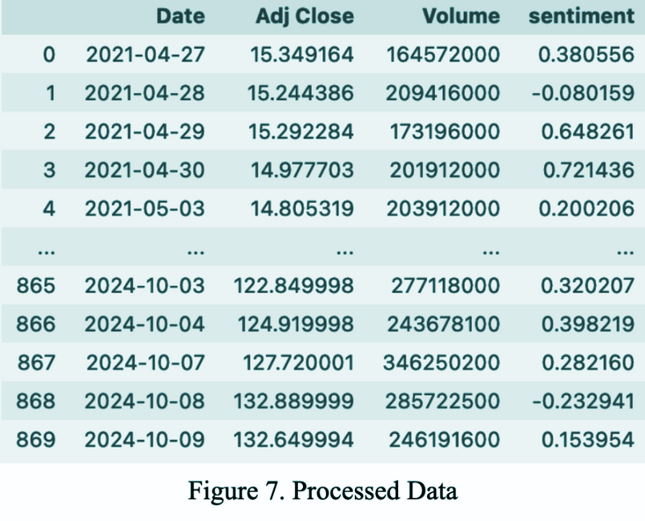
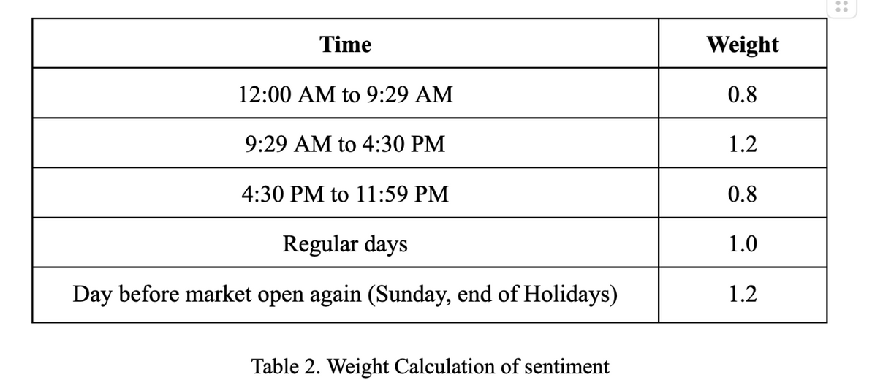
04
Sentiment Scoring
News data is processed through a fine-tuned FinBERT model for sentiment scores (Positive, Neutral, Negative), adjusted to a range of -1 to 1, with daily weighted averages emphasizing trading hours; these scores are then merged with stock data using Adjusted Close for analysis.

Slide 9
Analysis and feature engineering
Sentiment model
Predict model
Evaluate the impact of sentiment on stock prices as well as the effectiveness of the sentiment model
Provide additional insights and potentially enhance the performance of stock price forecasting models

Slide 10
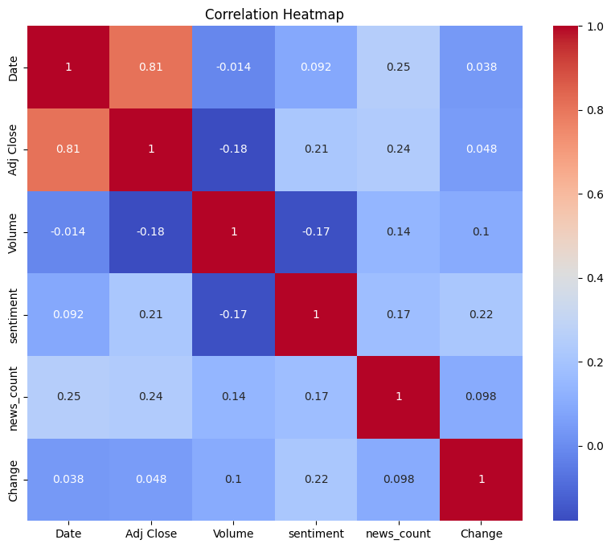
Correlation
Explore the relation ship between sentiment and other features
Top 3 features most relevant to sentiment:
Change
Adj close
News count

Slide 11
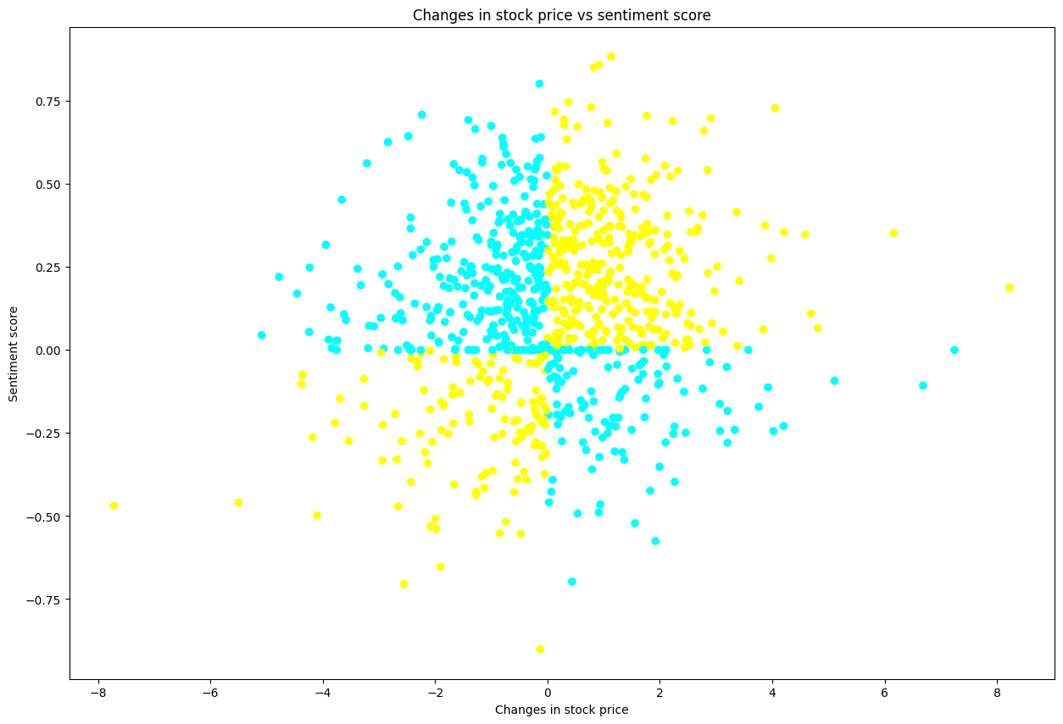

Change of stock price and sentiment
Both increase or decrease (yellow)
Not clearly visible
Create a new feature capturing when both metrics move in the same direction

Slide 12
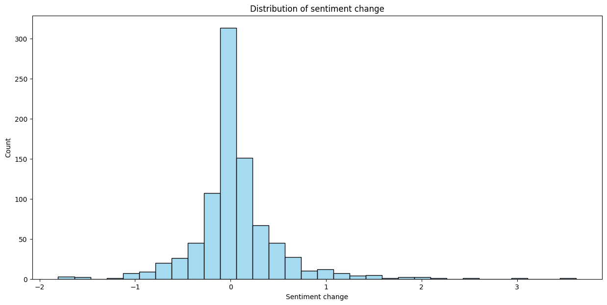
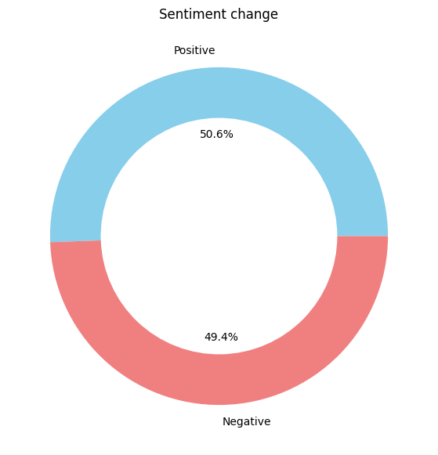
Change of stock price and sentiment

Slide 13

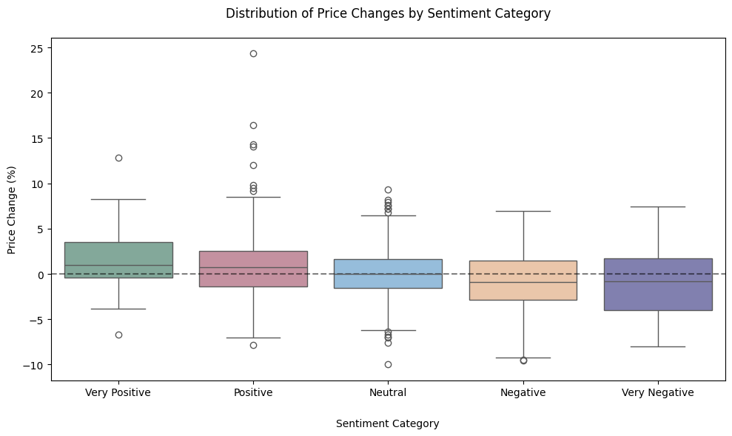
Distributution of price change by sentiment category
Positive sentiment categories: higher median price changes
Negative sentiment categories: lower median price changes

Slide 14
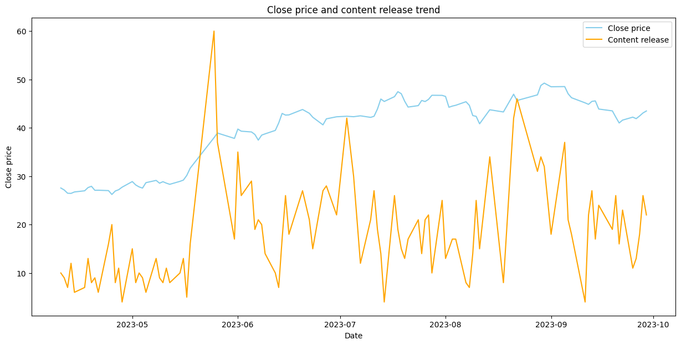


Stock price and sentiment
2 time periods before and after June 2023

Slide 15
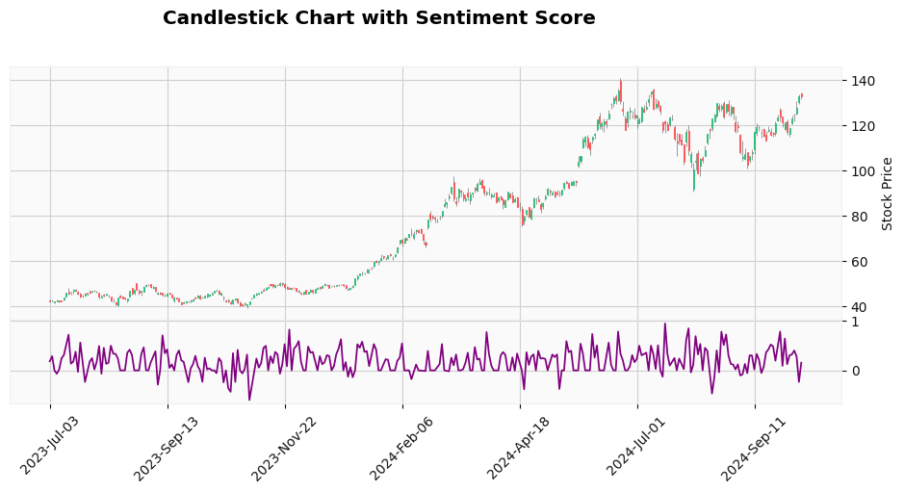
Stock price and sentiment

Slide 16
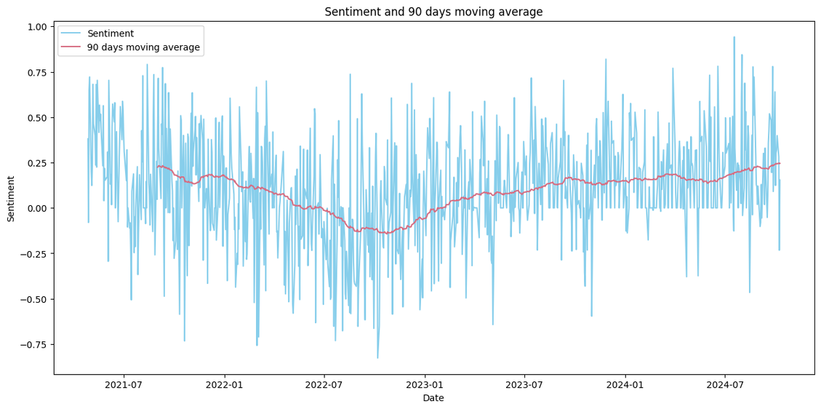
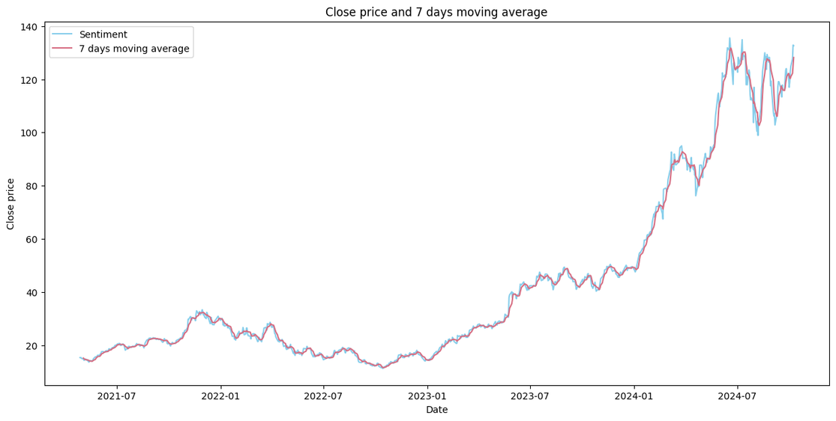
Moving average
Moving average : 0.20
Volatility: -0.15
Sentiment analysis: both short and long-term
Stock prices: only with shorter 7-day

Slide 17
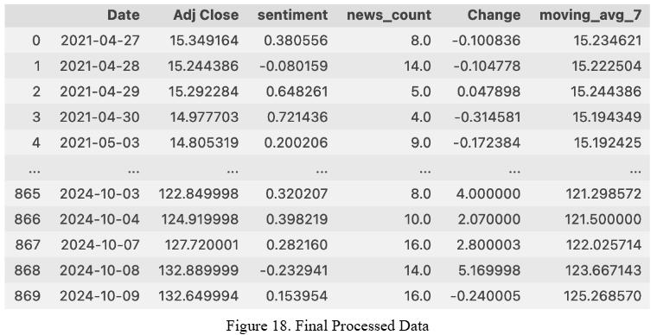
Features feed into predict model

Slide 18

Data Preparation
Modeling
Training and Testing Split: 85% of data for training, 15% for testing
Feature Categories:
Lagged Features: Adjusted Close, Stock Change, 7-day Moving Average
Real-time Features: Sentiment scores and news counts relevant to the prediction day.
Predict model
Comparing LSTM with vs. without sentiment features like Sentiment scores and news count

Slide 19
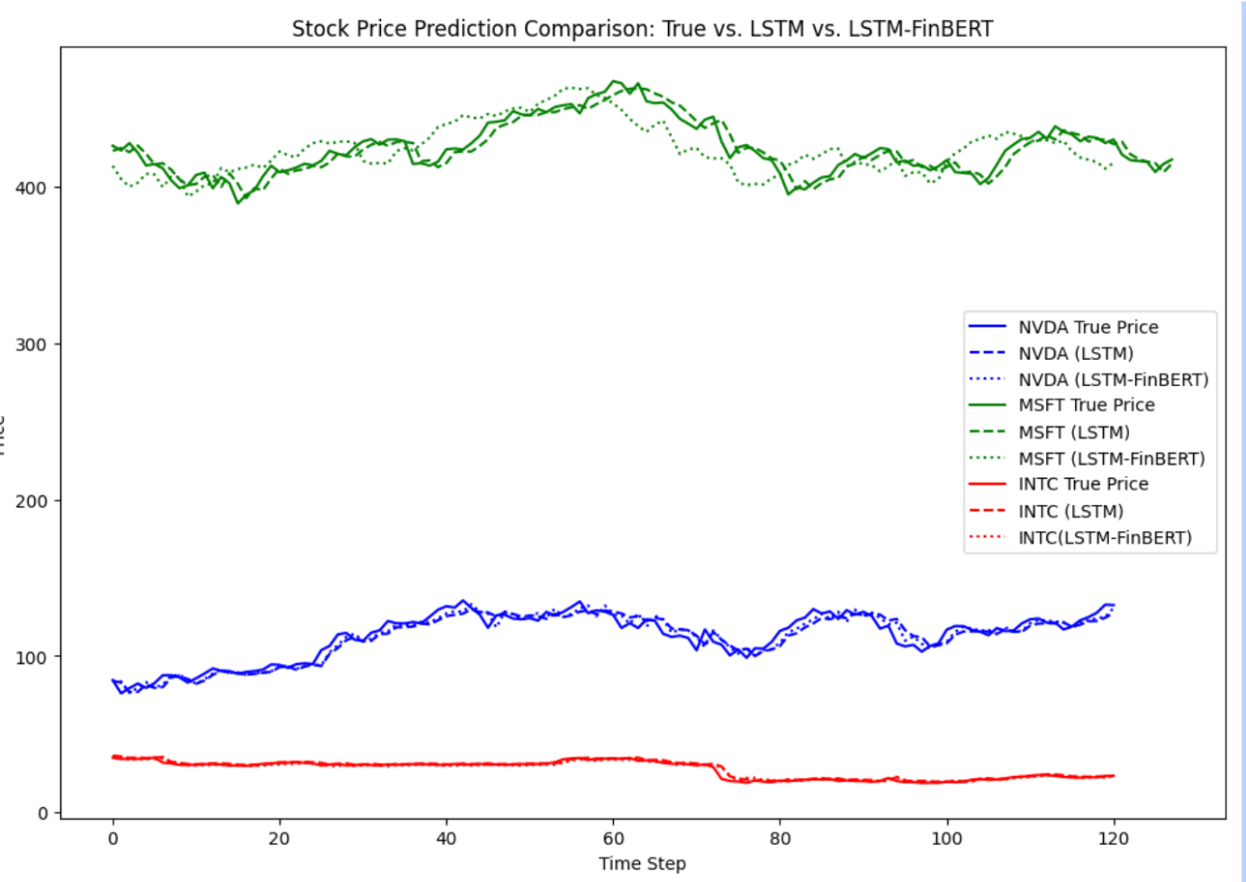
Modeling

Slide 20
Modeling
Model | MAE | MAPE | ACCURACY
NVDA (LSTM) | 3.98 | 0.035 | 0.964
NVDA (LSTM-FinBERT) | 3.34 | 0.018 | 0.971
MSFT (LSTM) | 4.40 | 0.010 | 0.989
MSFT (LSTM-FinBERT) | 4.01 | 0.007 | 0.992
INTC (LSTM) | 0.732 | 0.027 | 0.972
INTC (LSTM-FinBERT) | 0.633 | 0.018 | 0.981

Slide 21
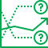
Forecasting
Data Preparation
Unseen data: 14 days from the end of the training data, only have news data.
Unseen data is processed like historical data to include daily sentiment and news count.
Predict model
Used the trained LSTM-FinBERT model on historical data to predict future outcomes.

Slide 22
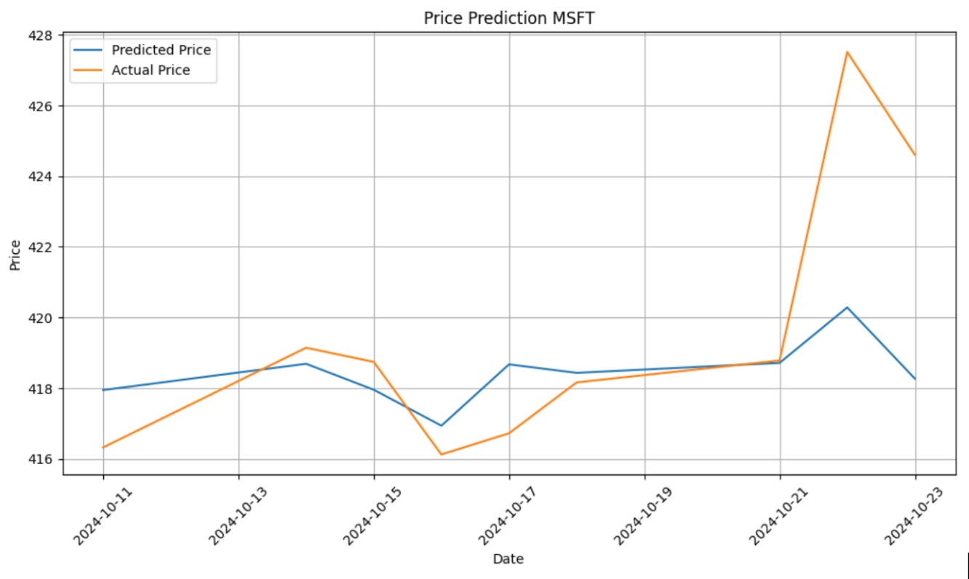
Forecasting

Slide 23
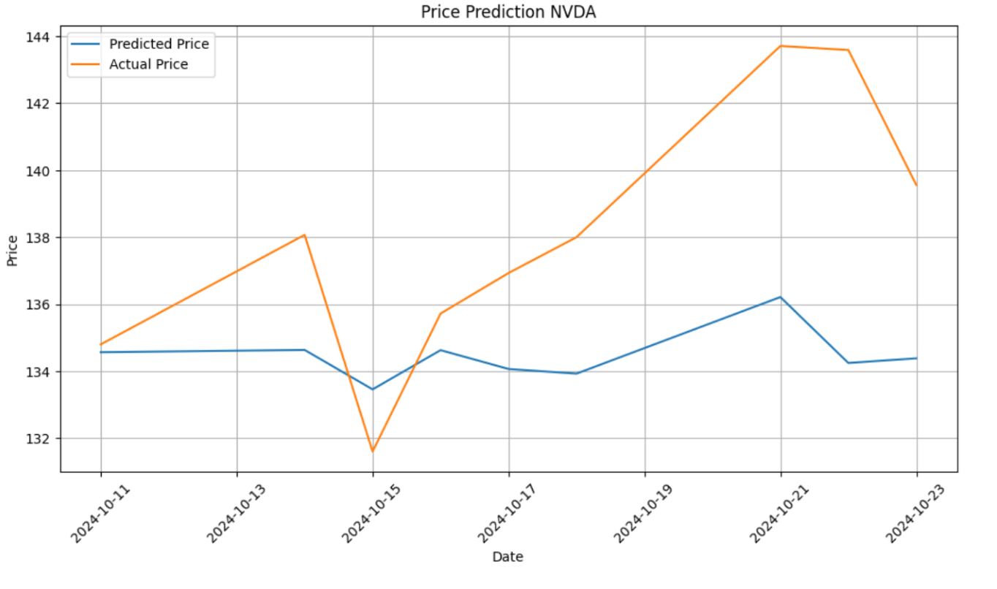
Forecasting

Slide 24
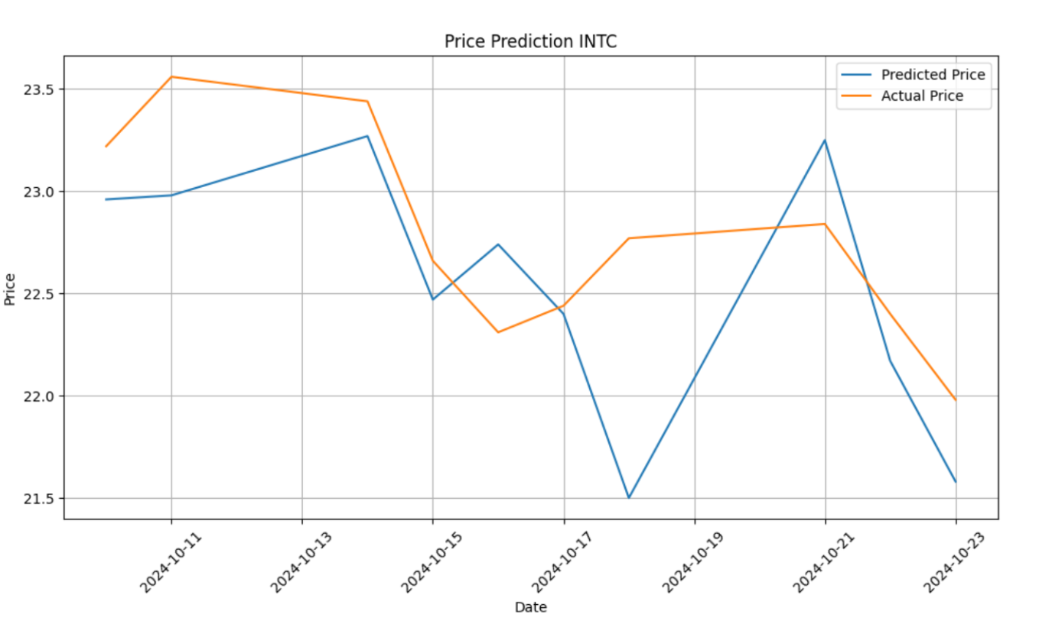
Forecasting

Slide 25
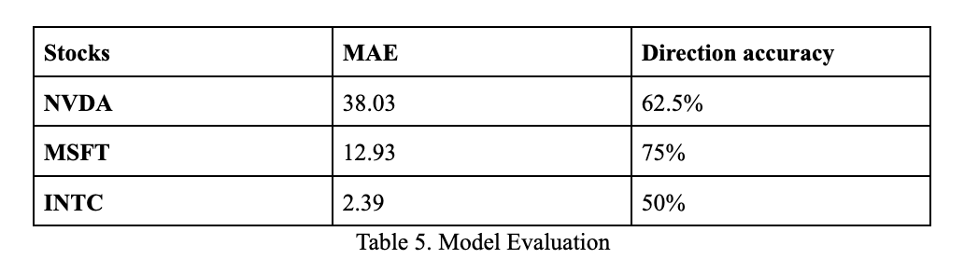
Forecasting

Slide 26
Discussion
Model perform good but not enough
Future work
Stock prices are significantly influenced by news and rumors.
Unable to predict price correctly
Numerous other factors can influence stock performance, including insider trading, inflation rates, and employment statistics.
Exploring more cutting-edge model
Expanding data and feature set like Twitter Tweets, Reddit Posts,.....

Slide 27


Thanks for Your Attention

